Slide 1
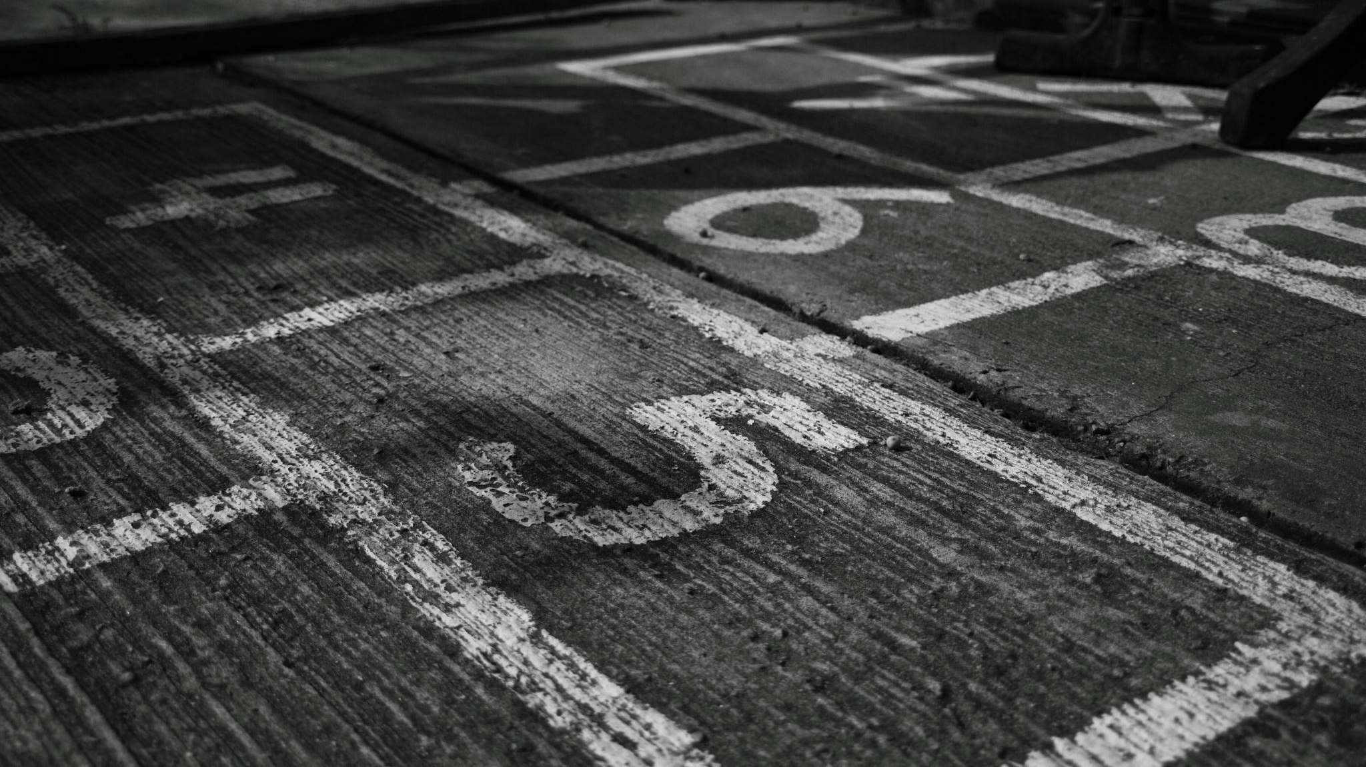
TRENDS IN CRIME (SEATTLE)
BY: ANTHONY WEN

Slide 2

INTRODUCTION
Purpose: analyze and discover trends that appear in crime in the city of Seattle – location, time, rates, nature of crime
Dataset from Kaggle: https://www.kaggle.com/datasets/adoumtaiga/crime-data-set
Crime reports for the city of Seattle for the last decade or so. Obtained from the Seattle Police Department’s incident reporting system and other public records.
Contains 15+ characteristic and 400,000+ rows of data

Slide 3
Questions
What are the most common crime in differrent districts of Seattle
At what time do most crimes occur
What Crimes are likely to happen?
How do the rates of crime change across time in different districts

Slide 4
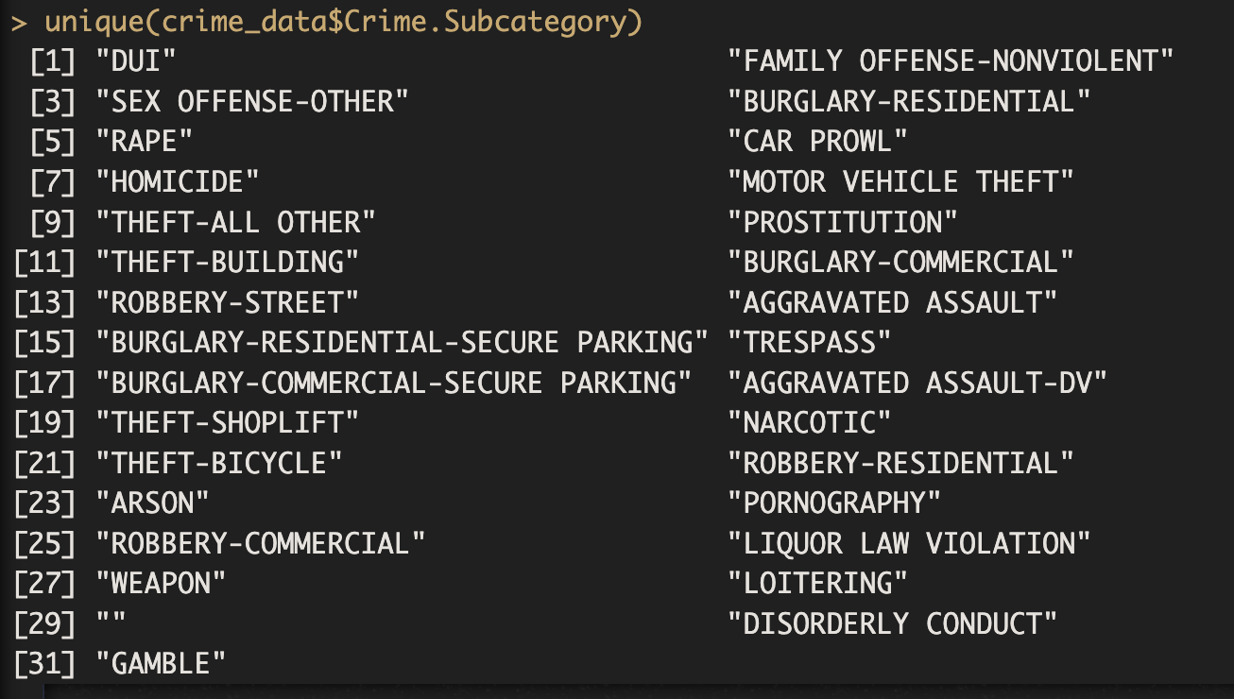
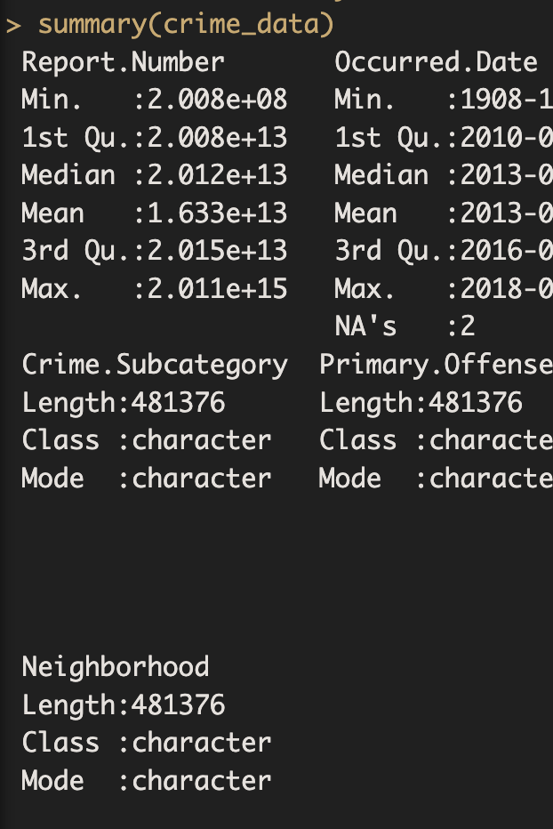
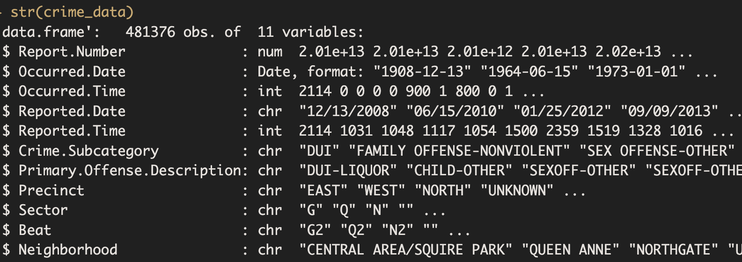
BASIC SUMMARY OF OVERALL DATASET

Slide 5
Spatial Graphs
Visualize distribution of crime/crime rates across different police beats (patrol area) in seattle
Use ggplot and shapefiles for the lines on the map
Answers Question Like: How do the rates of different types of crime change across time

Slide 6
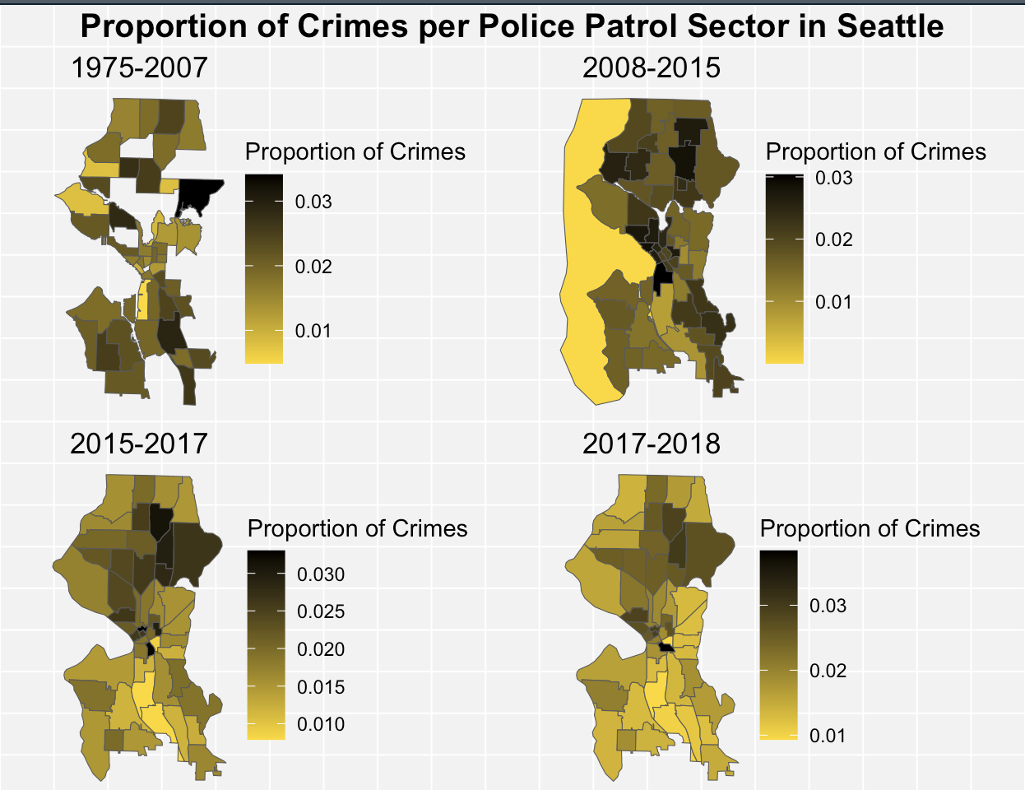
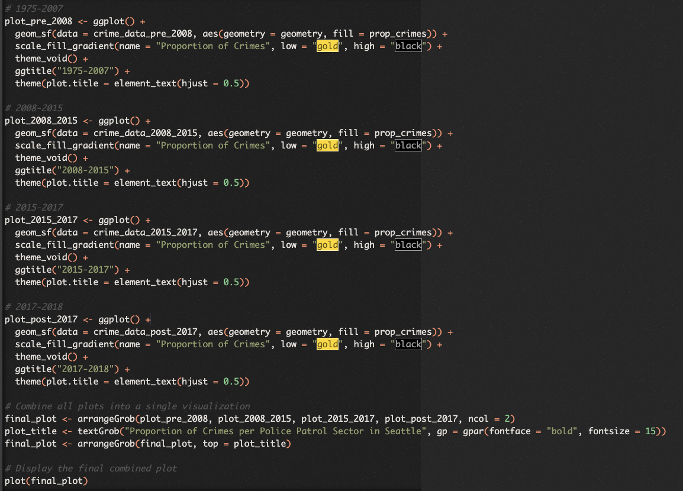

Slide 7
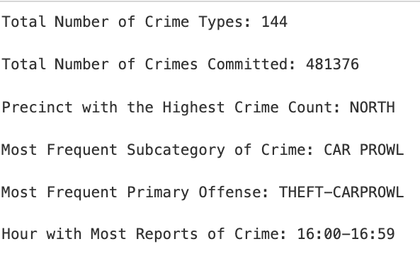
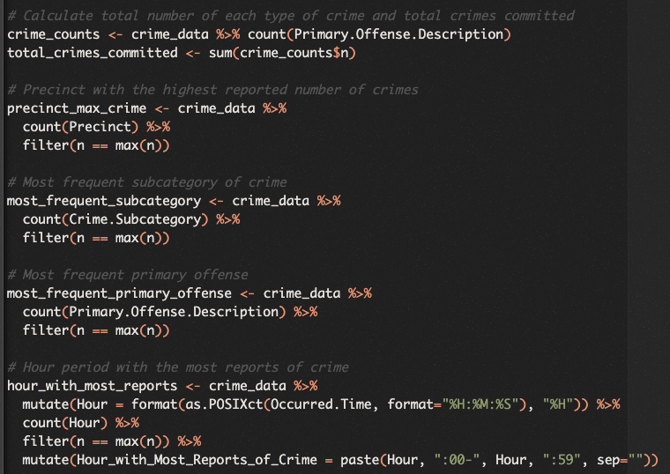
General Analysis and By Time of Day

Slide 8
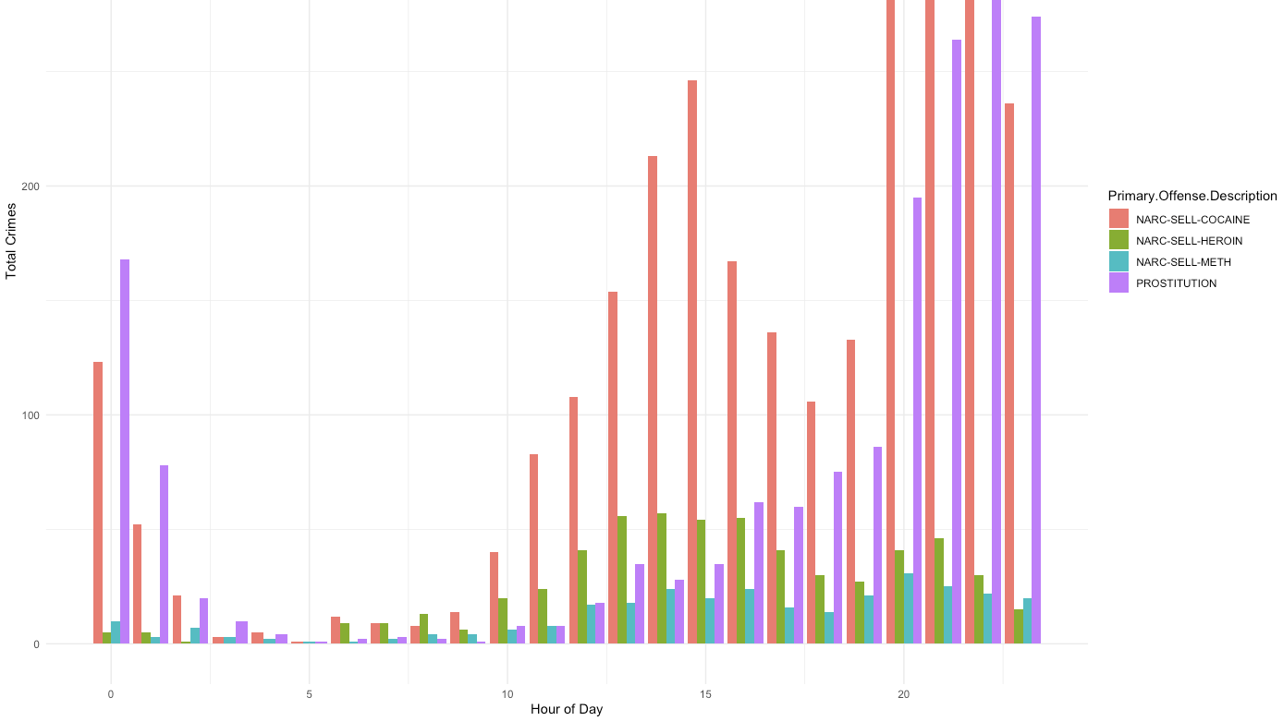
Data is Biased
only reported incidents are represented
Ignores background information on the crime
Only talking through numbers, ignores human nature/emotion

Slide 9
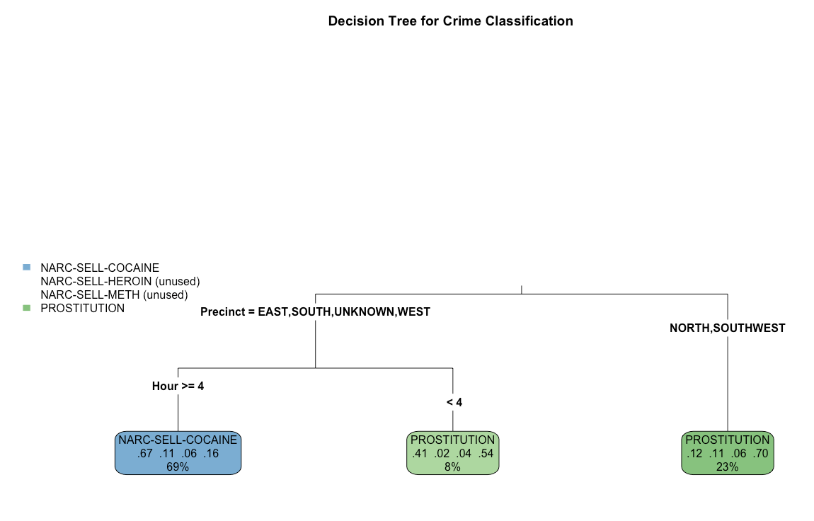
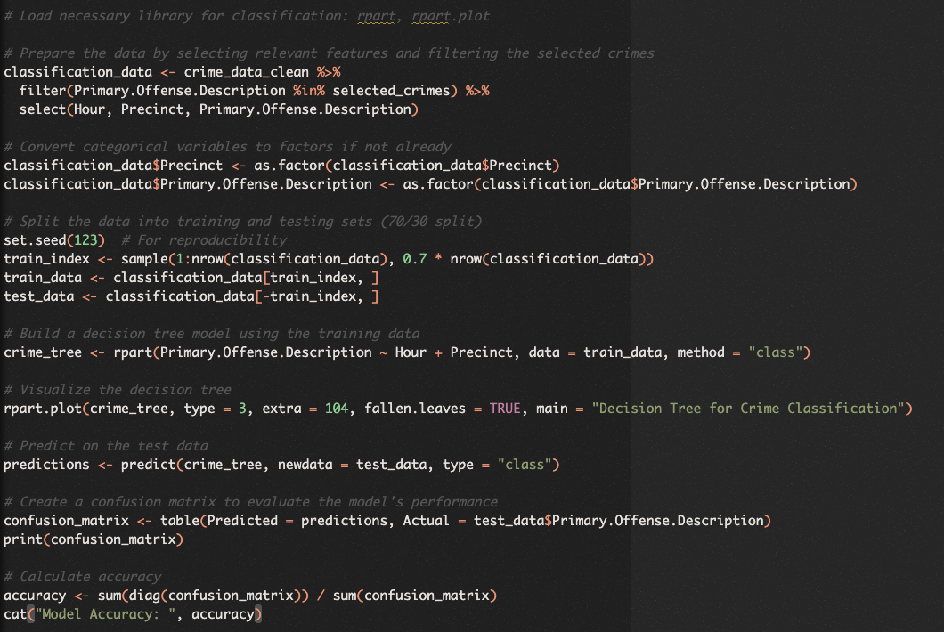
Predicting Crime (Prostitution and Drugs)

Slide 10
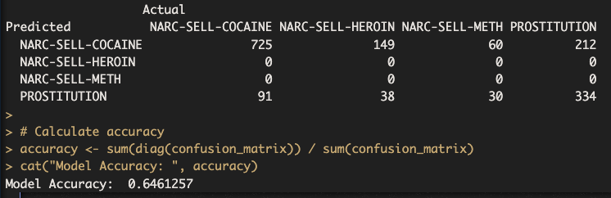
Classification
Classification model to try to predict the type of crime based on Hour and Precinct, dividing the data into branch based on these features. Training V.S. Testing Data has a 70/30 split (like ones in lab)
Predictor Variables:
Precinct: the police precinct where the crime occurred
Hour: hour of the day when the crime occurred
Results
69% of the crimes are related to selling cocaine in south
In the north and a bit of the southwest district, 70% related to be prostitution

Slide 11
Summary
1. What are the most common crime in different districts of Seattle? At what time do most crimes occur?
Shown in part #4 and 5, it seems that the most common crime is theft car prowl, but that might be different if we look at certain individual districts
these data could potentially be biased as they are only reported incidents
there seems to be trends that show that crime rates are increasing in north of Seattle and decreasing in the south, but these are just general trends from the past
2. How do the rates of crime change across time in different districts
Shown in part #4 with the spacial graphs and also #5
These crimes are concentrated during mostly the afternoon, indicating the need for targeted policing during these times.
3. What Crimes are likely to happen?
Shown in part #6, Certain general direction in Seattle show higher rates of prostitution and drug-related crimes, like in the north or southwest

Slide 12
Citations
Beat Files/Shape Files: https://data-seattlecitygis.opendata.arcgis.com/datasets/SeattleCityGIS::seattle-police-department-beats-2008-2015-web-mercator/about
Kaggle Dataset: https://www.kaggle.com/datasets/adoumtaiga/crime-data-set
Labs and Knowledge from Class

